Slide 1
HUB STORE
INSTALATION

Slide 2
AGENDA
CREATE TABLE SPACE
CREATE CMX MASTER
CREATE ORS
IMPORT SAMPLE ORS
CREATE ACTIVEVOS SCHEMA
SIP_ANT.LOG FILE

Slide 3
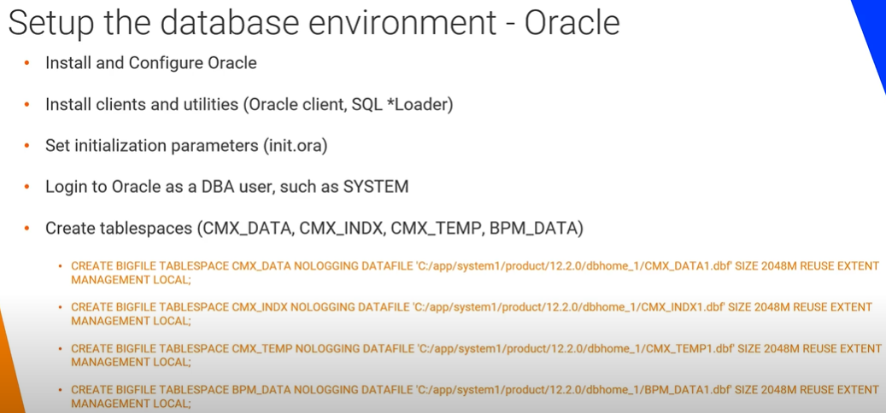

Slide 4
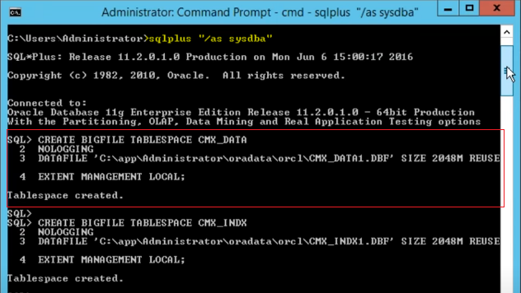
HUB STORE: TABLESPACE
Create 4 Table Space
CMX_DATA
CMX_INDEX
CMX_TEMP
BPM_DATA
Command to create TABLESPACE can be found in ADMIN Guide

Slide 5
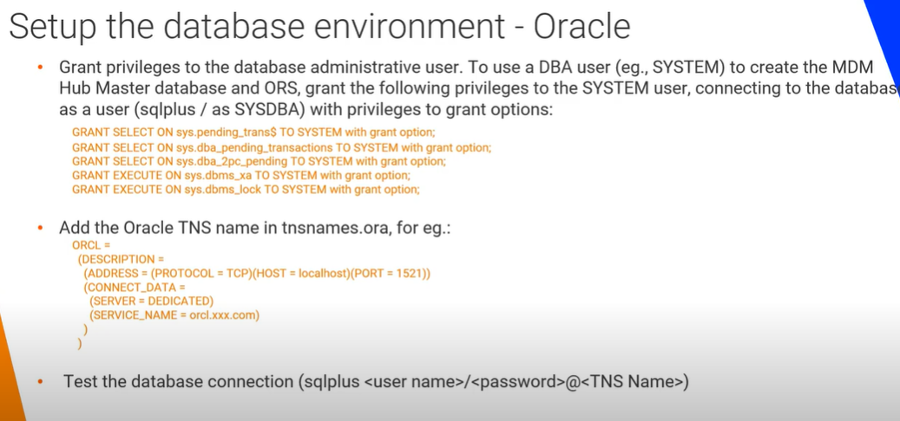

Slide 6
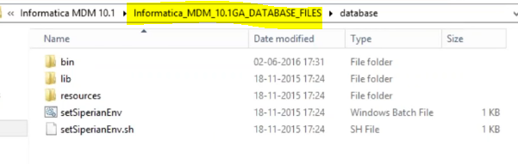
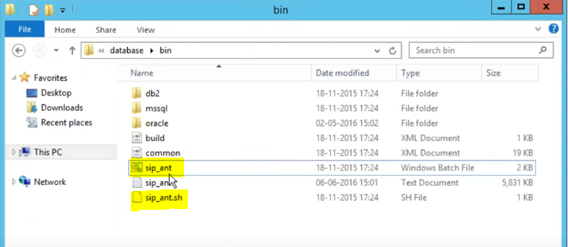
HUB STORE:
CREATE MASTER
Informatica MDM Data Base file.
This you will get as part of Informatica MDM Software.
To Create MASTER Data Base Schema Run :
Sip_ant.bat create_system

Slide 7
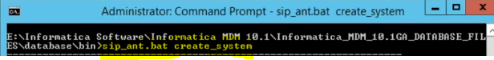
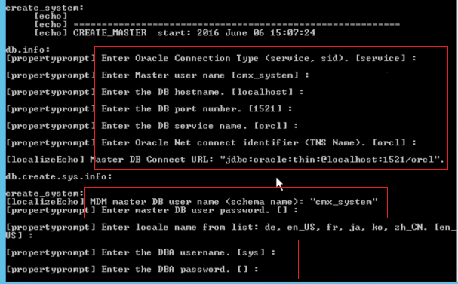
HUB STORE: CREATE MASTER
Go to Data Base → Bin folder and run sip_ant create_system
Use SYS DB user Id
Provide Host, Port , Service Information.
Give Master DB Schema and PW information.
Here CMX_SYSTEM is master schema name.

Slide 8
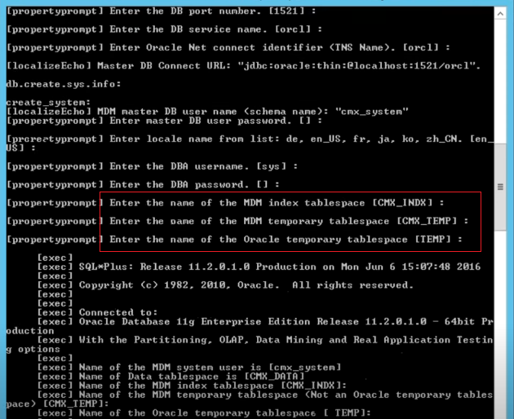
HUB STORE: CREATE MASTER
Give Table Space Information
It will take some time and will create empty MASTER DB Schema

Slide 9
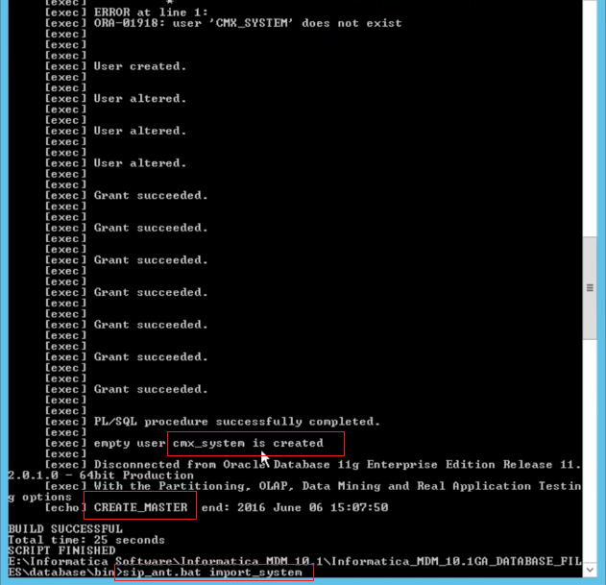
HUB STORE: IMPORT MASTER
Once cmx_system schema is created:
Now Import the MASTER DB
Run:
Sip_ant.sh import_system

Slide 10
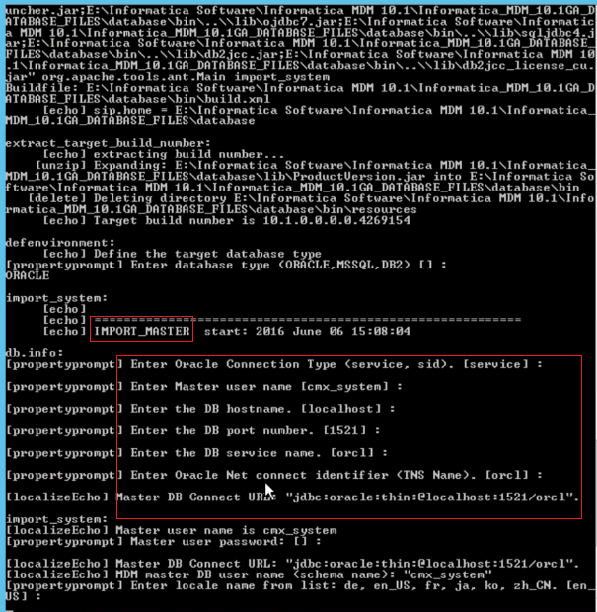
HUB STORE: IMPORT MASTER
Provide Host, Port, Service all information
Provide schema name as “cmx_system”, which was created in earlier steps.

Slide 11
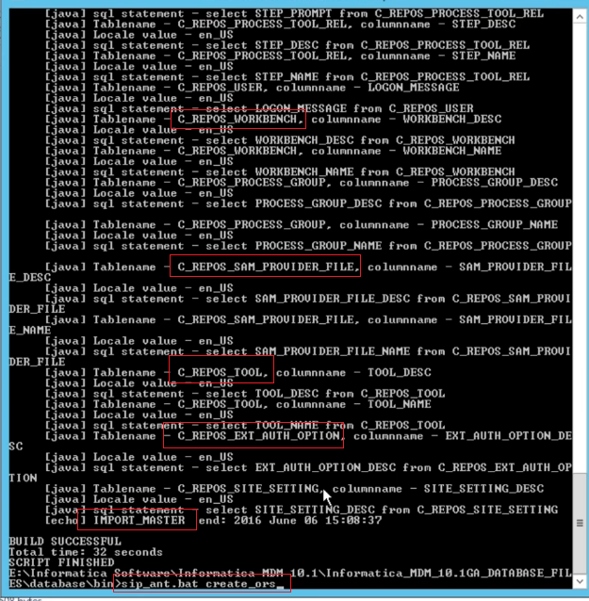
HUB STORE: IMPORT MASTER
All REPOS table that is needed for MDM MASTER schema (CMX_SYSTEM) will get imported.
Highlighted are few REPOS tables

Slide 12
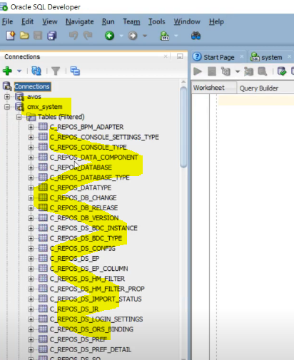
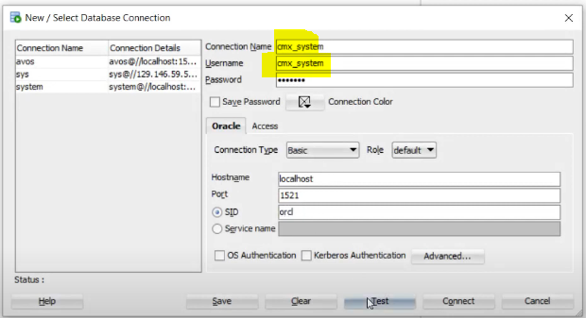
HUB STORE: IMPORT MASTER
Connect to DB and check cmx_system schema

Slide 13
HUB STORE: CREATE ORS
You can create a empty ORS
Or you can do this later
To Create an empty ORS:
Run:
Sip_ant.bat create_ors

Slide 14
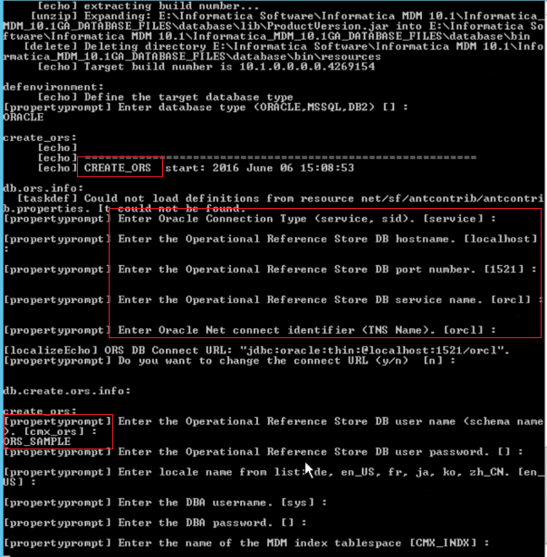
HUB STORE: CREATE ORS
Provide Host, Port, Service etc
Give ORS name like ORS_SAMPLE, CUSTOMER_ORS etc
An Empty ORS will be created.

Slide 15
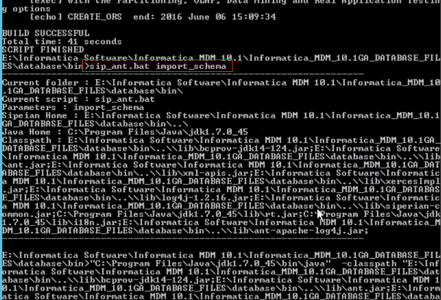
HUB STORE: IMPORT SCHEMA
This is optional. Not related to installation
Sip_ant.bat import_schema

Slide 16
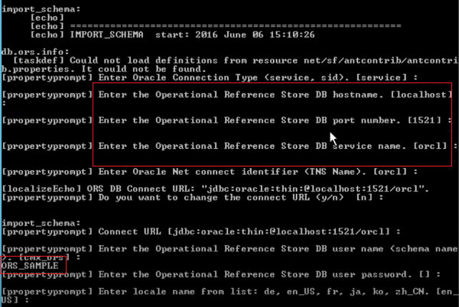
HUB STORE: IMPORT SCHEMA
Provide Host, Port all information.
Give schema name as “ORS_SAMPLE”

Slide 17
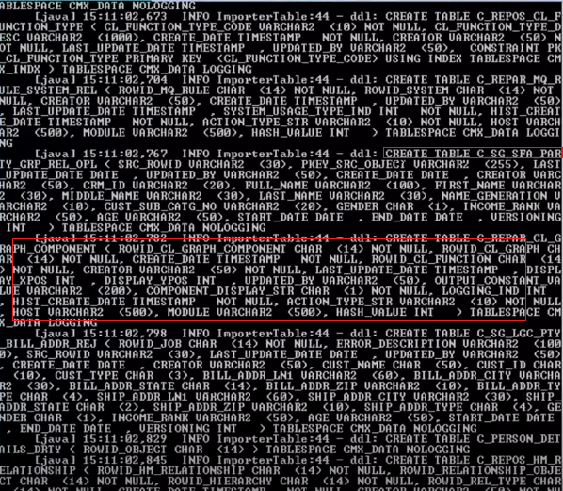
HUB STORE: IMPORT ORS
Sample Tables and column will be imported to SAMPLE ORS.

Slide 18
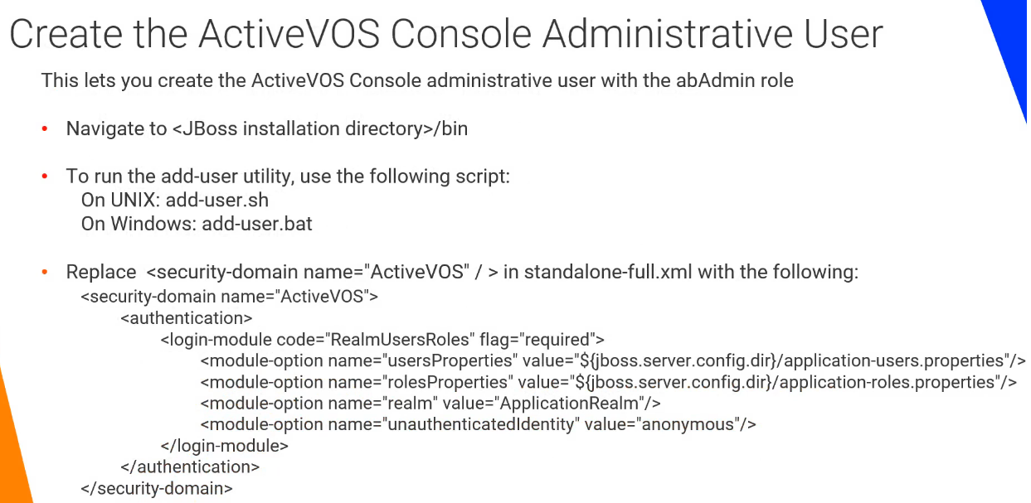
HUB STORE: ACTIVEVOS
If you want to install ActiveVOS independent of Hub Server Configuration, then follow these steps.

Slide 19
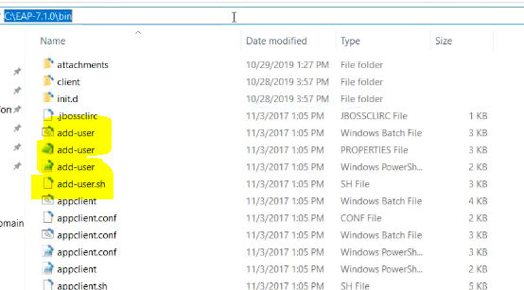
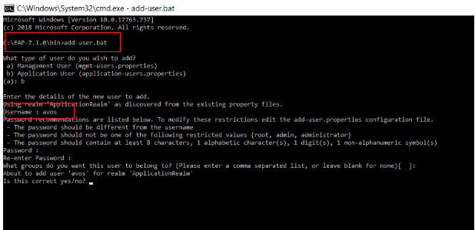
HUB STORE: ACTIVEVOS
Create AVOS user in JBOSS application server.
Go to JBOSS → Bin Folder → Run “Add-User.sh” script
Provide user name as AVOS

Slide 20
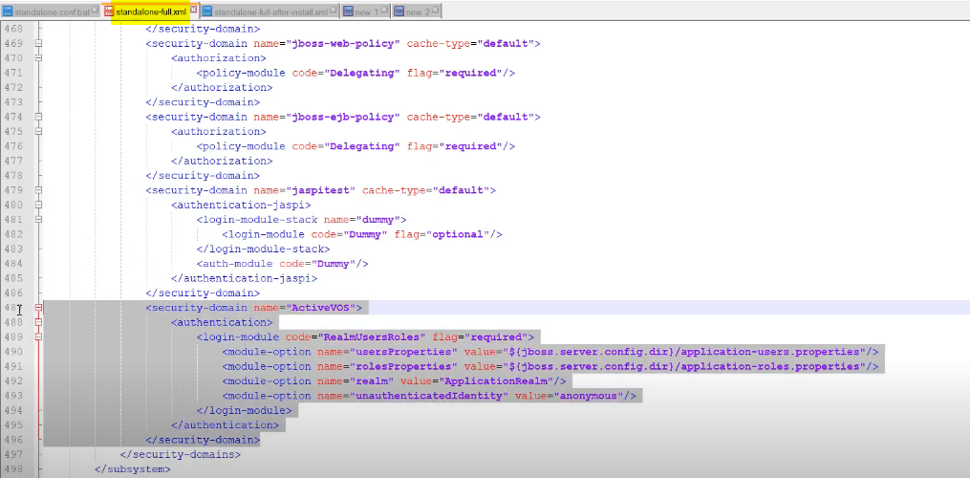
HUB STORE: ACTIVEVOS
Add ActiveVOS security domain info in JBOSS standalone-full.xml file

Slide 21
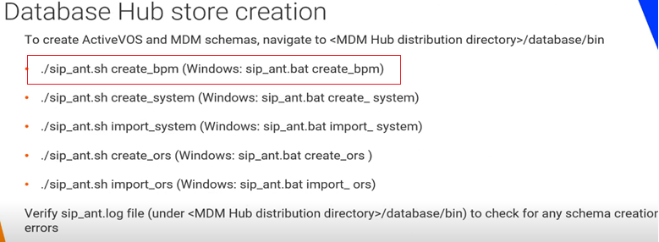
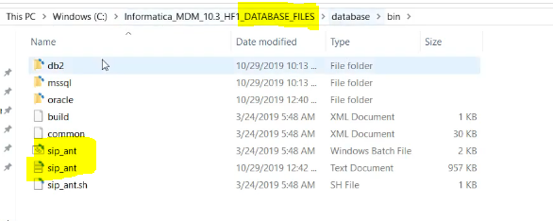
HUB STORE: ACTIVEVOS
To Create AVOS Schema → Run :
Sip_ant.sh create_bpm
Sip_ant script will be found in downloaded software

Slide 22
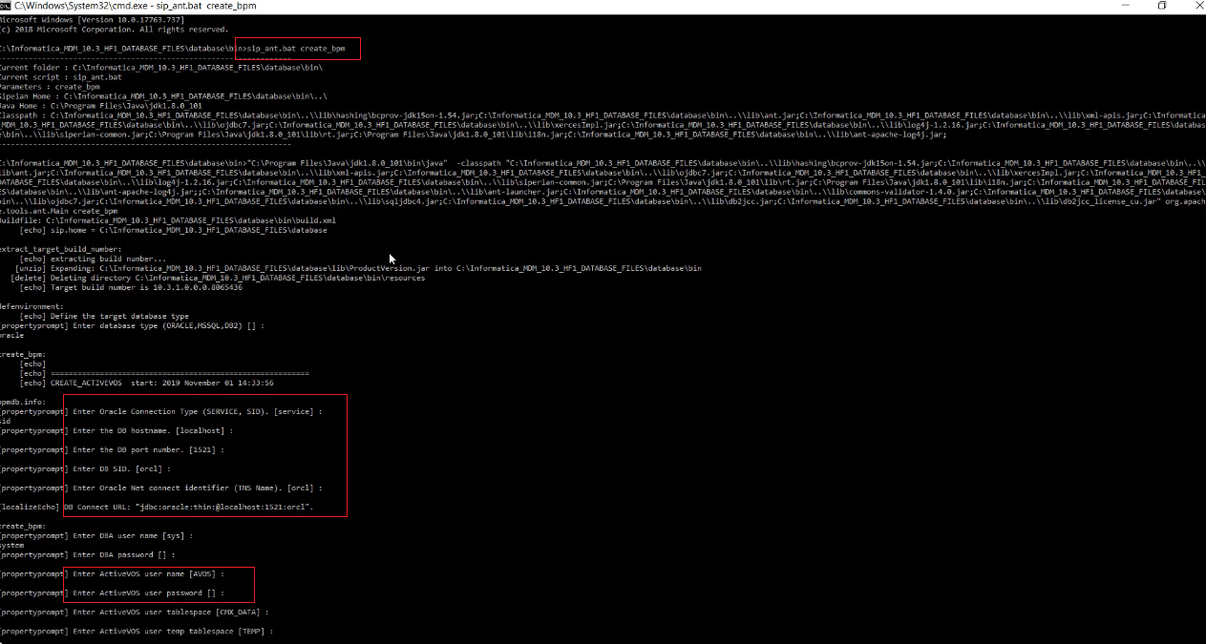
DB Host, PORT info
AVOS user Id will be used. Which you create in previous steps

Slide 23
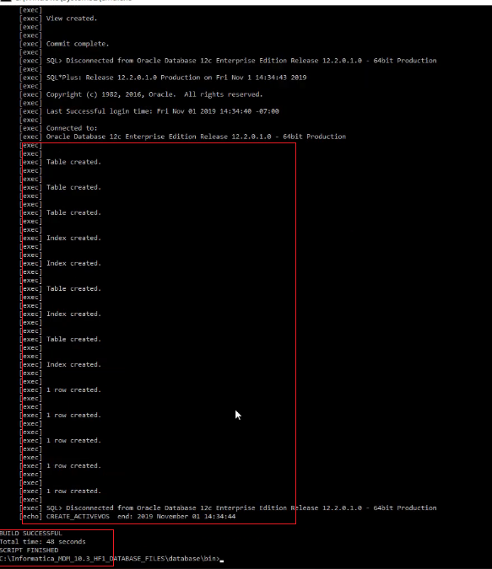
HUB STORE: ACTIVEVOS
AVOS schema is created.

Slide 24
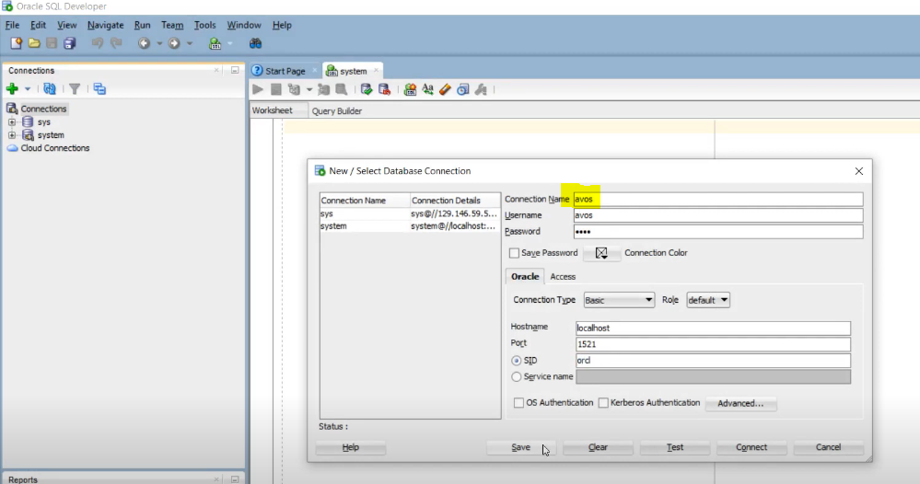
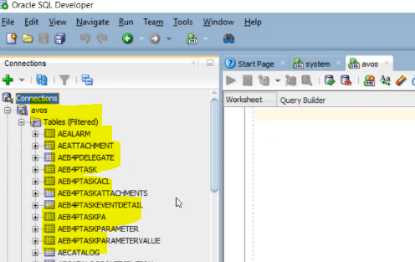
HUB STORE: ACTIVEVOS
To Create AVOS Schema → Run :
Sip_ant.sh create_bpm
Sip_ant script will be found in downloaded software

Slide 25
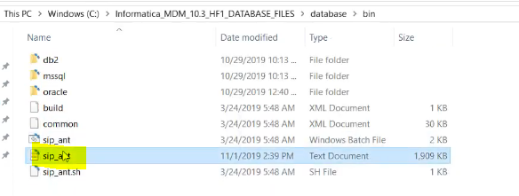
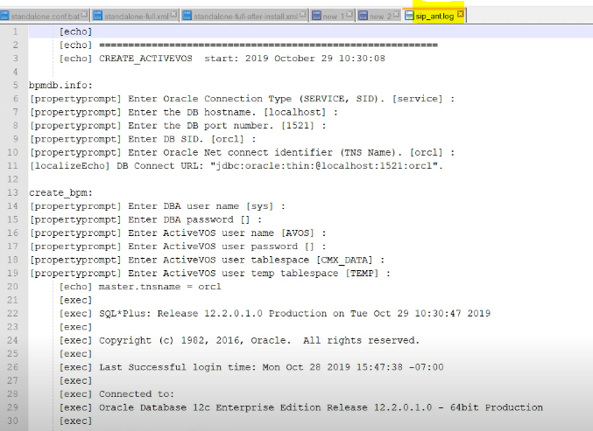
HUB STORE:
SIP_ANT.LOG
Refer sip_ant.log file to see any error occurred during Hub Store setup

